Slide 1
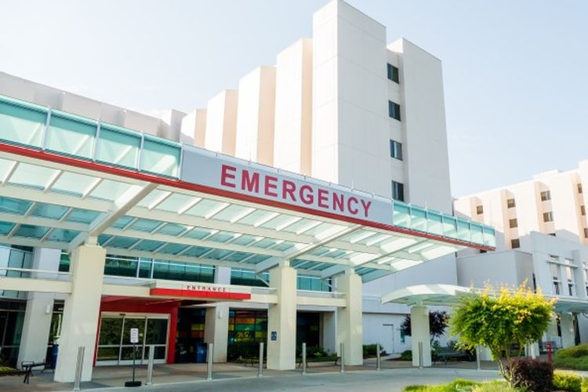

JAKARTA’S MEDICAL CENTERS
FINDING THE BEST LOCATION TO BUILD NEW MEDICAL CENTERS IN JAKARTA

Slide 2
INTRODUCTION
Despite having the most medical centres in Indonesia, Jakarta’s medical facilities are far from adequate. Jakarta needs more medical facilities in order to increase the well-being of its people.
This project aims to find the best districts to build new medical centres in Jakarta by considering the number of existing medical centres available within those districts and the total population.
This project may help Jakarta’s Government and investors who are planning to build new medical centres in Jakarta.

Slide 3
DATA
The main data used in this project are the location of existing medical centres on each district which are generated from Foursquare API using the coordinate data of each district (bps.go.id).
For better decision making, the population data from Statistics Indonesia’s website (bps.go.id) are also used to find districts with the lowest rate of medical centres per population.

Slide 4
METHODOLOGY
K-means method on transformed data is performed to cluster the districts. Clustering the districts help us to find potential district group which fall into our criteria and understand how those groups differ from the others.
After selecting the potential group, the existing medical centres of each district in the group is plotted in using density-based heatmap.
The districts which are the furthest from the existing medical centres will be chosen as the final potential districts.

Slide 5
RESULTS (1)
Districts in cluster 0 generally have lower number of medical centres and MC per Population compared to districts in cluster 1. Therefore, districts in cluster 0 are chosen as the potential districts to build new medical centres.
The districts that are located the furthest from existing medical centres are : Kepulauan Seribu Selatan, Kepulauan Seribu Utara, Cilincing, Cakung, Ciracas and Cipayung. Those districts are chosen as our final potential districts.

Slide 6
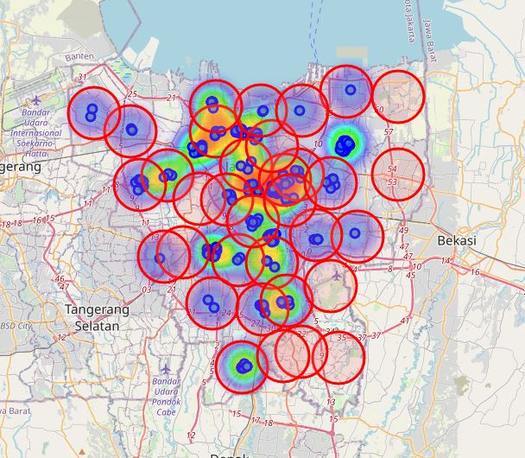
RESULTS (2)

Slide 7
DISCUSSION
Kepulauan Seribu Selatan or Kepulauan Seribu Utara is the perfect choice as it is located the furthest from existing medical centres.
However, if the investor prefers to build a new medical centre in the mainland then Cakung can be a perfect choice since it has more population than the rest.
Some further data analysis by considering economical and environmental factors may be required to find the best district for the new medical centre.

Slide 8
CONCLUSION
Jakarta’s medical facilities are far from adequate.
New medical centres are need to be built in order to increase the well-being of its people.
After performing analysis, we found that the potential locations to build new medical centres are Kepulauan Seribu Selatan, Kepulauan Seribu Utara, Cilincing, Cakung, Ciracas and Cipayung.
The optimal location among those potential districts is Kepulauan Seribu Selatan or Kepulauan Seribu Utara.
However, if the investor prefers to build a new medical centre in the mainland then Cakung can be a perfect choice.

